Slide 1
FAN BEAM CT
Anand P Kadumberi
Neethu Lekshmi
Sharmi Ravindran

Slide 2
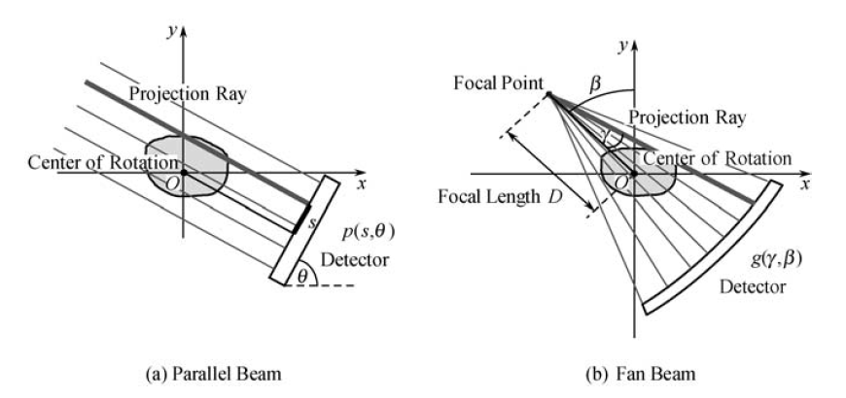
PROJECTION GEOMETRIES
Single X-ray source and ring of detectors
Source rotates and projection is taken at each angle
The dark gray ray in both parallel and fan beam configurations are the same. Therefore occupy the same point in sinogram

Slide 3
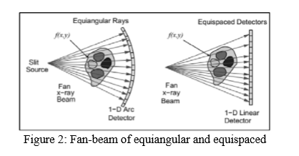
TYPES OF DETECTORS

Slide 4
EVOLUTION OF CT GEOMETRY
First Generation: Parallel Beam Geometry
Second Generation : Fan beam, Multiple Detectors
Third Generation: Fan beam, Rotating Detectors
Fourth Generation: Fan beam, Fixed Detectors
Fifth Generation: Scanning Electron beam
Current CT scanners uses third, fourth or fifth generation geometries.

Slide 5
PARALLEL VS FAN BEAM GEOMETRY
Parallel beam | Fan beam
Relatively simple and straight forward | Interpolate fan beam projections into parallel beam projections
Employs large amount of radiation | Uses a single source
Expensive and not feasible | It is economical and cost effective
Ring artifacts, significant noise and vibrations | Currently used in field applications
Parallel beam uses simple reconstruction algorithm. | Fan beam are converted to parallel prior to image reconstruction
Acquisition time is higher, hence slower | Fan beam CT is much faster and has reduced scanning time

Slide 6
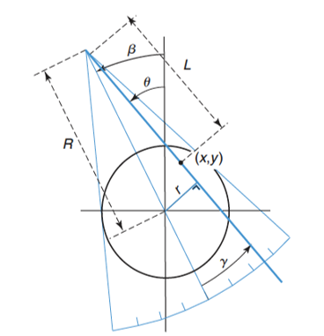
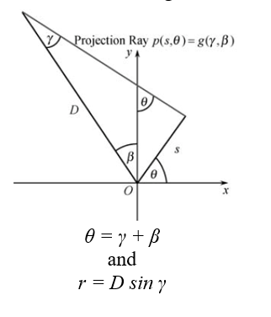
PRINCIPLE OF FAN BEAM CT

Slide 7
REBINNING TECHNIQUE
p (r, θ) = g (γ, β)
r = x cos θ + y sin θ; s= - x sin θ + y cos θ
x = r cos θ - s sin θ; y = r sin θ + s cos θ
x=R cos ϕ; y=R sin ϕ;
p(r, θ) = ∫∫ δ(R, ϕ) δ(x cos θ+y sin θ- r) dx dy
r = R cos(θ -ϕ)
Applying the above rebinning conditions for fan beam CT,
g(D sin γ, γ +β) = ∫∫ δ(R, ϕ) δ(x cos (γ +β) +y sin (γ +β )- D sin γ) dx dy
r = R cos(γ + β -ϕ)

Slide 8
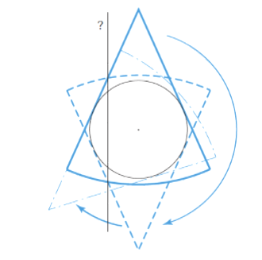
360 DEGREE ACQUISITION (FULL SCAN)

Slide 9
FILTERED BACKPROJECTION
b(x,y)= f(x,y) ⊗ 1/√x2 +y2
B(ωx, ωy)= F(ωx, ωy) ⊗ 1/√ωx² +ωy²
F(ω_{x}, ω_{y})= B(ω_{x}, ω_{y})⊗ |ω|
f(x,y)= IF[F(ω_{x}, ω_{y})]= IF[B(ω_{x}, ω_{y})⊗ |ω|]

Slide 10
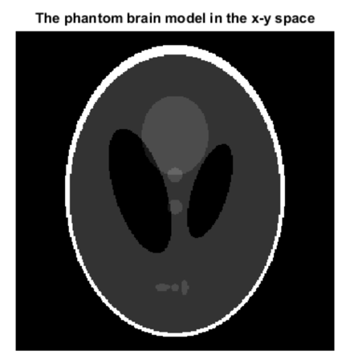
IMAGE RECONSTRUCTION USING MATLAB

Slide 11
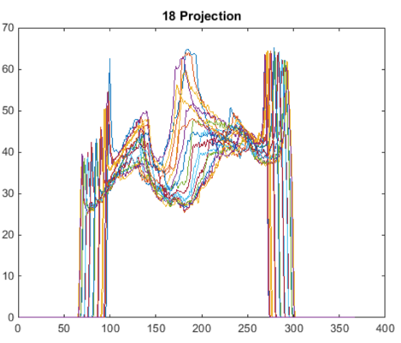
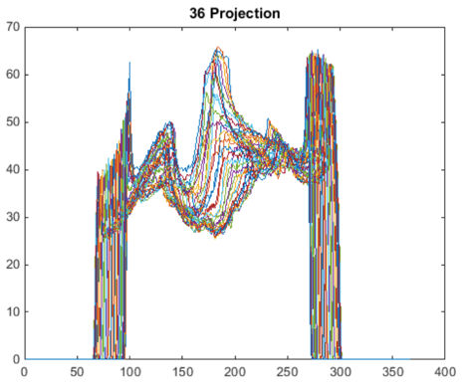
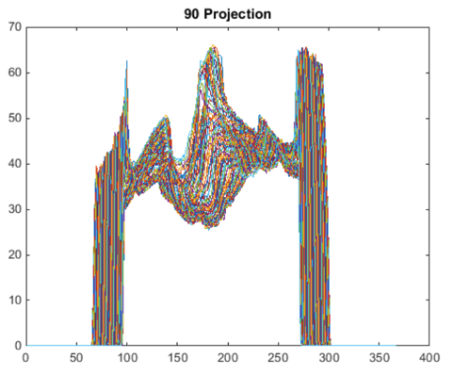
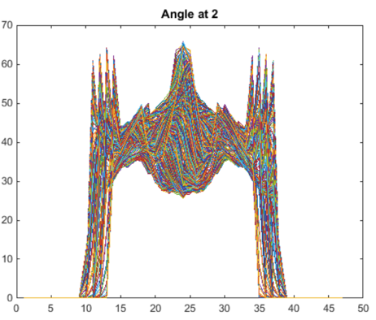
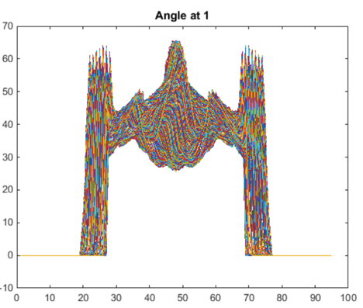
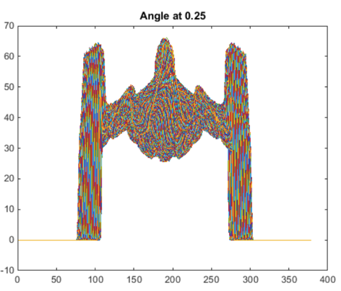
PROJECTIONS
‘Radon’
p(r,𝜃)
‘Fanbeam’
(‘Radon’ + ‘Para2fan’)
g (𝛾, β)
𝜃 = β + 𝛾
r = D sin 𝛾
Notes:
Projection can be taken from 0 to pi for parallel beam; but 0 to 360 + 2* fan angle for fan bean (full scan) 0 to 180 + 2*fan angle (short scan)

Slide 12
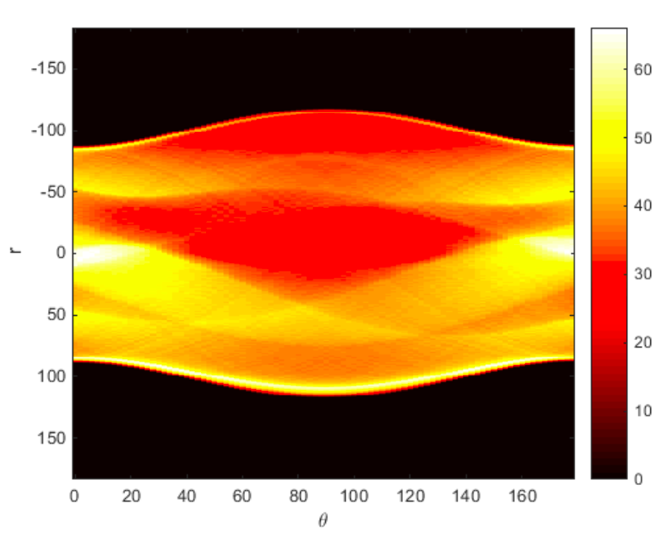
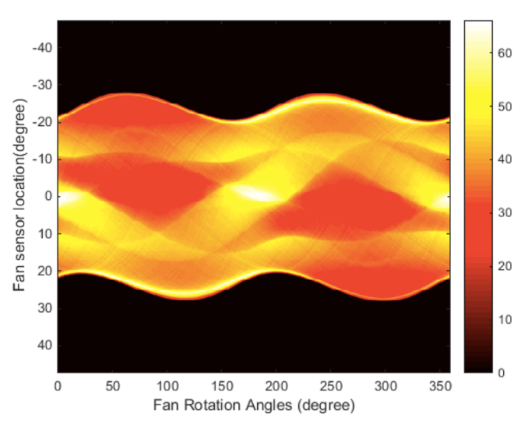
SINOGRAM
PARALLEL BEAM CT
FAN BEAM CT
r=R cos (𝜃 - ϕ)
D sin 𝛾 =R cos (β + 𝛾 - ϕ)

Slide 13
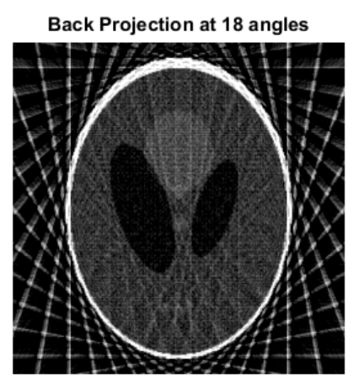
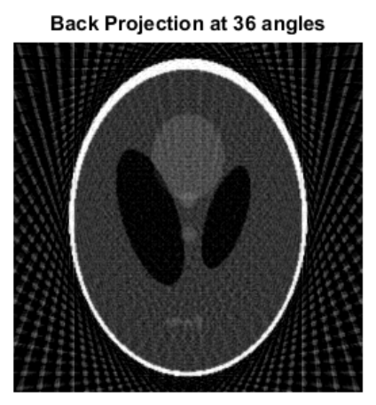
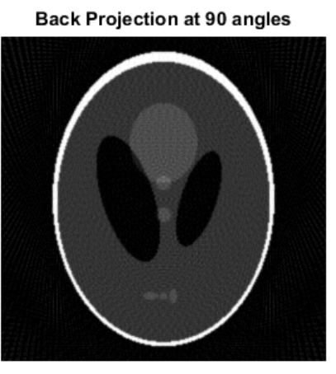
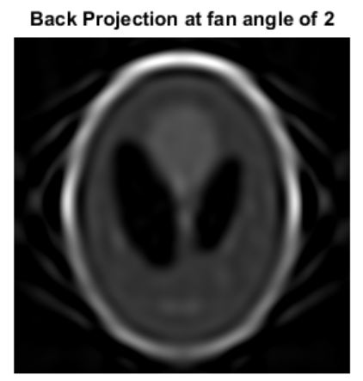
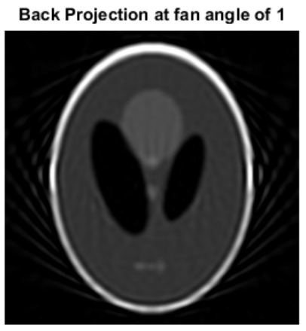
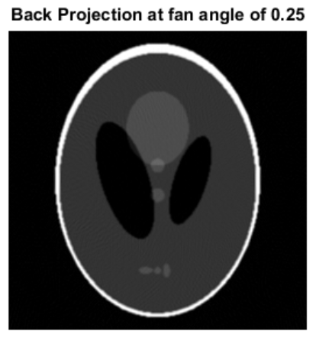
FILTERED BACKPROJECTION
‘iRadon’
∫p(r,𝜃)d𝜃
‘iFanbeam’
(‘iRadon’ + ‘Fan2para’)
β + 𝛾 = 𝜃
D sin 𝛾 = r

Slide 14
REFERENCES
M.S.M. Yusoff, R. SulaimanImage Image reconstruction of computed tomography using fan-beam Technique (2012). J. Eng,CS&Tech 0105: 06 – 11.
Paul Suetens. Fundamentals of Medical Imaging (2nd edition) (2011). European journal of nuclear medicine and molecular imaging 38(2):409-409.
Gengsheng Zeng. Medical Image Reconstruction: A Conceptual Tutorial (2010). ISBN: 978-3-642-05367-2 (Print) 978-3-642-05368-9.

